Slide 1
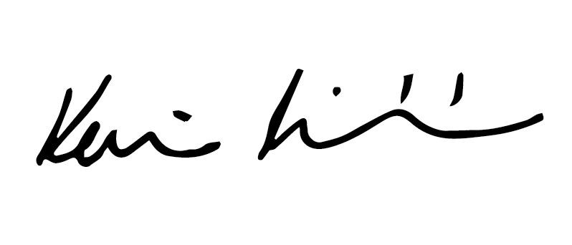
FORS Silver
Readypower Rail Services
has been assessed and has met the Silver level requirements of the Fleet Operator Recognition Scheme (FORS).
Single Operating Centre Accreditation applies to the following location only: RG41 5TP
This certificate is valid from 26/06/2020 to 25/06/2021 and remains valid as long as FORS requirements continue to be maintained.
Kevin Richardson
on behalf of the Fleet Operator Recognition Scheme
FORS ID : 001728

